Slide 1

Join this livestream…
Hey Class! Be awesome and
join.me/337-329-686
© 2016 | RCB - All Rights Reserved
Notes:
7:00 – 7:05

Slide 2
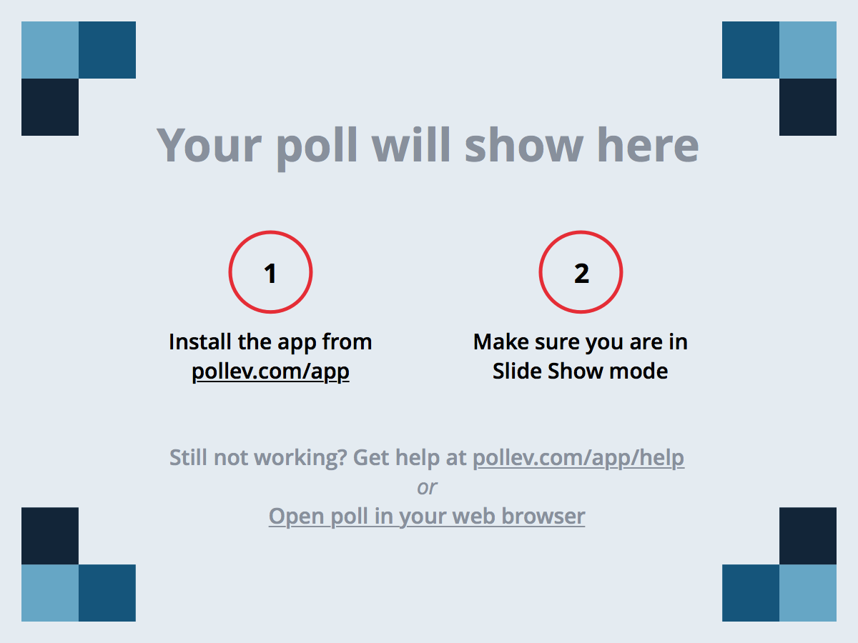
Notes:
Poll Title: During RCB, which of the following has been MOST helpful to your learning? https://www.polleverywhere.com/multiple_choice_polls/rLHIDvpgHzxQ5ho

Slide 3
The Joys of Javascript
Day 7
Rutgers Coding Bootcamp | February 8, 2016
© 2016 | RCB - All Rights Reserved
Notes:
Start at 6:45 PM

Slide 4
A Few Admin Items…
© 2016 | RCB - All Rights Reserved
Notes:
7:00 – 7:05

Slide 5

Attendance + Homework
Remember!
Class Attendance is Mandatory. Don’t miss more than 4 classes unless you have extenuating circumstances.
You must complete 23 / 24 homework assignments.
Student Success tracks these items.
Anyone failing to meet requirements won’t be able to access career services.
DON’T LET THAT HAPPEN TO YOU!!!
© 2016 | RCB - All Rights Reserved
© 2016 | Rutgers Coding Bootcamp - All Rights Reserved

Slide 6
Back to the Basics: Git + Terminal
Tuesday (February 9) – 9:30 – 10:10 PM
I’ll be hosting a Basics Session on Git and Terminal.
This is primarily intended for folks who are pretty lost and/or could use a refresher on:
File Navigation + Terminal Coordination
Git Cloning
Git Pushes (Concept and Approach)
Git Branching and Checkouts
Git Pull Requests
© 2016 | RCB - All Rights Reserved
© 2016 | Rutgers Coding Bootcamp - All Rights Reserved

Slide 7
Homework #2 – Questions?
Two parts to the assignment
Take existing Portfolio and apply Media Queries and Viewport to make mobile responsive.
Find a Bootstrap theme you like and apply the Bootstrap theme to your website.
© 2016 | RCB - All Rights Reserved
© 2016 | Rutgers Coding Bootcamp - All Rights Reserved

Slide 8
Javascript!
© 2016 | RCB - All Rights Reserved
Notes:
7:00 – 7:05

Slide 9
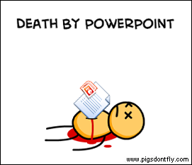
Au Revoir Mr. Powerpoint!
© 2016 | RCB - All Rights Reserved
© 2016 | Rutgers Coding Bootcamp - All Rights Reserved

Slide 10
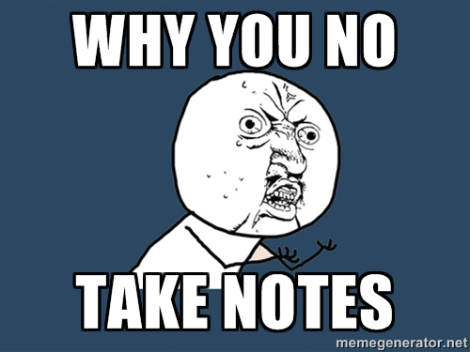
Time to Take Notes..
© 2016 | RCB - All Rights Reserved
© 2016 | Rutgers Coding Bootcamp - All Rights Reserved

Slide 11

And Keep Organized!!!
© 2016 | RCB - All Rights Reserved
© 2016 | Rutgers Coding Bootcamp - All Rights Reserved

Slide 12
> YOUR TURN!!
15 min
Code Dissection:
Save the code sent to you via slack.
Open it in Chrome and watch what happens.
Then open the file in Sublime and try to explain to your partner what’s happening line-by-line.
p.s. I know we haven’t covered Javascript before…
© 2016 | RCB - All Rights Reserved
Notes:
Send snapshot from Git command line

Slide 13
Variables and Alerts
© 2016 | RCB - All Rights Reserved
Notes:
7:00 – 7:05

Slide 14
> YOUR TURN!!
10 min
Code Creation:
Create code using Javascript that does all of the following:
Asks the user with a confirm: “Do you like _____” and store it into a variable.
Ask the user “What kind of ________” do you like with a prompt and store that into a variable.
Alert both variables to the screen.
© 2016 | RCB - All Rights Reserved
Notes:
Send snapshot from Git command line

Slide 15
Conditionals
© 2016 | RCB - All Rights Reserved
Notes:
7:00 – 7:05

Slide 16
> YOUR TURN!!
10 min
Code Creation:
Create code using Javascript that does all of the following:
Asks the user if they like ______________.
If they do, then write the following: “I made you _________”
Otherwise, write: “Too bad. I don’t care”.
Bonus:
Ask the user what their birth year is. Then…
If its greater than yours, create an alert saying: “You’re older than me”.
If it’s the same, create an alert saying: “You’re around my age”.
If its smaller than your age say: “You’re younger than me”.
© 2016 | RCB - All Rights Reserved
Notes:
Send snapshot from Git command line

Slide 17
More JS!
© 2016 | RCB - All Rights Reserved
Notes:
7:00 – 7:05

Slide 18
> YOUR TURN!!
15 min
Code Dissection:
Retype the code shown on the screen
Then discuss with those around you what’s going to get alerted to the screen.
Hint: There will be multiple outputs.
© 2016 | RCB - All Rights Reserved
Notes:
Send snapshot from Git command line

Slide 19
Break!
© 2016 | RCB - All Rights Reserved
Notes:
7:00 – 7:05

Slide 20
Arrays
© 2016 | RCB - All Rights Reserved
Notes:
7:00 – 7:05

Slide 21
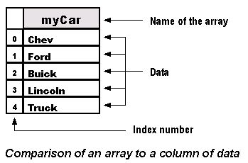
Arrays – “Lists of Things”
© 2016 | RCB - All Rights Reserved
Notes:
Send snapshot from Git command line

Slide 22
> YOUR TURN!!
10 min
Code Creation:
Start with this array…
var = animalsIWant = [“lizards”, “skunks”, “chipmunks”]
Then ask the user to guess an animal you want.
If the animal is in the array, alert: “You guessed Right!”
Hint: Use the indexOfMethod that will be slacked out to you.
© 2016 | RCB - All Rights Reserved
Notes:
Send snapshot from Git command line

Slide 23
> YOUR TURN!!
10 min
Code Creation:
With the person next to you, make a list of 5 of your favorite bands/musicians and put it inside of an array and store that into a variable called myFavoriteMusicians
Ask the user for a band/artist, turn the input lower case and then tell the user if the band is one of your favorites.
© 2016 | RCB - All Rights Reserved
Notes:
Send snapshot from Git command line

Slide 24
> YOUR TURN!!
20 min
Code Creation:
With the person next to you, using the below arrays:
var Gameboy = [ ‘Game boy’, ‘nintendo’, 149.99 ];
var pokemon = [ ‘Pokemon Blue’, “nintendo’, 49.99];
var tetris = [ ‘Tetris’, ‘Sega’, 49.99];
How would you (without changing the variable declarations):
Change the name of the Gameboy to “Game Boy Color”
Change the company of the pokemon game to capitalized.
Remote the prise of Teris and store it into a variable called oldPrice, then put in a new price of 9000.99 in the array.
Set the company of the tetris array to Nintendo
© 2016 | RCB - All Rights Reserved
Notes:
Send snapshot from Git command line

Slide 25
Next Homework!
© 2016 | RCB - All Rights Reserved
Notes:
7:00 – 7:05

Slide 26
Questions?
© 2016 | RCB - All Rights Reserved
Notes:
7:00 – 7:05

Slide 27
Recap
© 2016 | RCB - All Rights Reserved
Notes:
7:00 – 7:05

